Slide 1
VDA 5050 Implementing a universal TypeScript/JavaScript library
Software Architecture & Design Usage examples

Slide 2
VDA 5050 – Specification for Driverless Transport Systems (DTS) Interface for the communication between AGVs and master control
Overview
Joint project team and standardization effort driven by VDA and VDMA*
Current specification versions 1.1 and 2.0
Objectives
Create a universally applicable and uniform interface to coordinate automated guided vehicles (AGV) by a master control (e.g. fleet manager)
Enable parallel operation with AGVs from different manufacturers and conventional systems in the same work environment
Reduce complexity and increase plug-and-play capabilities across transport vehicles, vehicle models, and manufacturers
Increase manufacturer's independence using common interfaces between vehicle control and coordination level
** VDA - German Association of the Automotive Industry, VDMA Materials Handling and Intralogistics Association

Slide 3
VDA 5050 – Specification for Driverless Transport Systems (DTS)* Interface for the communication between AGVs and a master control
Master Control for AGVs coordination plane
Automated Guided Vehicles vehicle plane
Master Control
MQTT Broker
AGV
Manage AGV operations
vehicle status (cyclic / on change)
State.schema
motion status (high frequency, optional)
Visualization.schema
Communication interface**
uses MQTT, a broker-based pub-sub messaging protocol with JSON payload format
Assign orders
Initiate actions
Carry out / cancel orders and actions
order (nodes and edges with actions)
Order.schema
instant actions
InstantActions.schema
status of order and instant actions State.schema
Track AGV connection state
connection state (online – offline, published by AGV or MQTT last will) Connection.schema
** According to VDA 5050 Specification Version 1.1
** Designed to support a minimum of 1000 vehicles with different degrees of autonomy
Notes:
Loose coupling between master controls and AGVs: endpoints do not know about each other, i.e. no point-point connections
One Master Control can control many AGVs
One AGV can be controlled by many Master Controls (e.g. a passive one for visualizing AVG state (dashboard); an active on for assigning orders, …)

Slide 4
Universal VDA 5050 TypeScript/JavaScript Library Motivation
VDA 5050 specification characteristics
Overly rich and opinionated feature set, encompassing all types of AGV (e.g. line-guided, free navigation) and satisfying dedicated requirements of AGV users and manufacturers involved
Complex control logic and information flows on coordination and vehicle plane
No reference implementation yet; huge effort to implement one
Key objectives of library
Encapsulate complex control logic into reusable and interoperable components
Provide abstraction layers for coordination/vehicle plane and communication
Provide uniform protocol to adapt to vehicle-specific navigation & control interfaces
Use library components on coordination/vehicle plane in combination or separately
Support custom VDA 5050 actions and extension topics/object models

Slide 5
Universal VDA 5050 TypeScript/JavaScript Library Software architecture with configurable, extensible, and pluggable components
Master Controller
Abstraction layer over control logic of coordination plane
Assign orders and initiate instant actions to AGVs
Report order/instant action execution state to application
Master Control Client
Pub-Sub abstraction layer over MQTT messaging
Target individual, all, or a subset of AGVs within the DTS
Track AGV connection state
Autogenerate VDA 5050 object types from JSON schemas
Autogenerate MQTT topic-payload from VDA 5050 objects
Configurable MQTT protocol version (3.1.1, 5.0)
Configurable MQTT transport options: TCP, WebSocket, TLS
Configurable MQTT topic structure to support Edge brokers
Configurable automatic reconnect
Configurable regular heartbeat exchange with MQTT broker
Offline buffering of publications and subscriptions
Validation of inbound and outbound VDA 5050 messages
Efficient subscription-based message dispatching
Supports all standard VDA 5050 topics and schemas
Extensible by custom VDA 5050 topics and schemas
AGV Client
Pub-Sub abstraction layer over MQTT messaging
AGV Controller
Abstraction layer over control logic of vehicle plane and vehicle-specific navigation & control
AGV Adapter
Mfr. X
AGV Adapter
Mfr. Y
AGV Adapter
…
AGV Adapter
VIRTUAL
Process orders and instant actions according to VDA 5050 logic
Manage & report vehicle/order/action state to master controller
Provide uniform AGV interface for plug-in adapters
PLC
NavigationControl
Safety
PLC
NavigationControl
Safety
…
NavigationControl
Safety
Virtual AGV
NavigationControl
Safety
Traverse edge; Stop traversing edge
Execute, terminate, cancel a node, edge, or instant action
Report changes in action & vehicle state to AGV controller
Check if route traversable, action executable, AGV within deviation
Calculate trajectory paths (if required)
Notes:
Master Control/AGV Client components can also be used independently of controller components
AGV controller handles order-related logic, AGV adapter handles low-level non-order-related operations

Slide 6
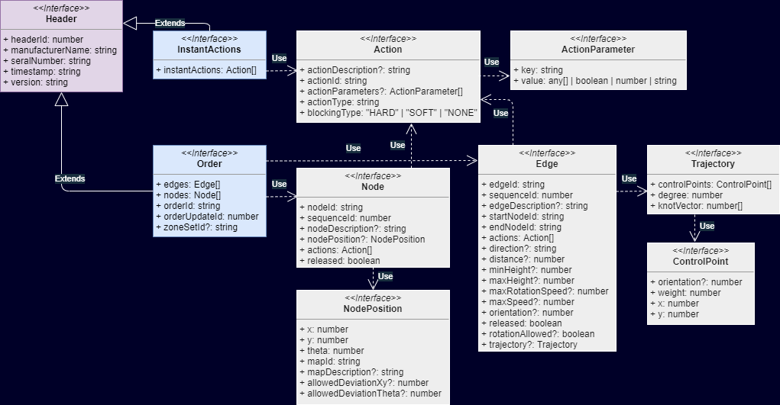
Universal VDA 5050 TypeScript/JavaScript Library VDA 5050 object types*: InstantActions, Order
* VDA 5050 object types for TypeScript are automatically generated from VDA 5050 JSON schemas using npm package vda-5050-cli

Slide 7
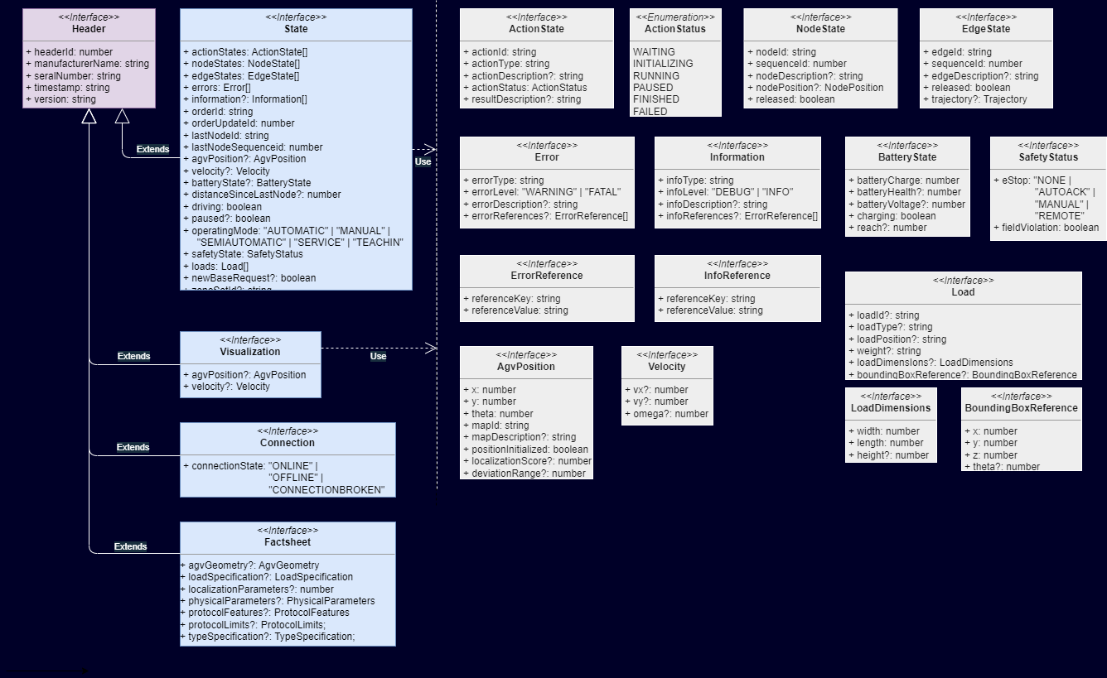
Universal VDA 5050 TypeScript/JavaScript Library VDA 5050 object types: State, Visualization, Connection, Factsheet (V2.0)

Slide 8
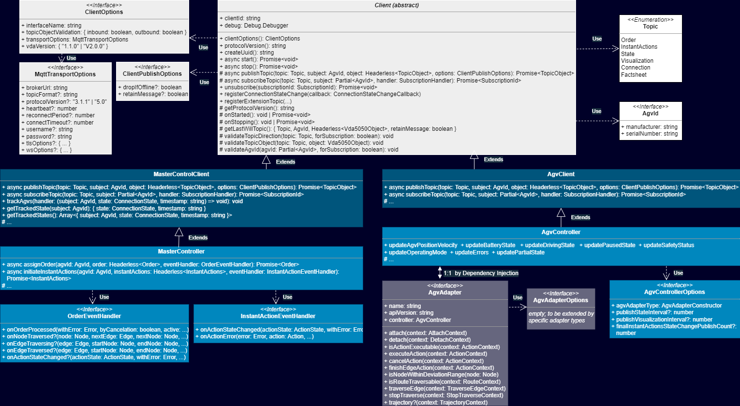
Universal VDA 5050 TypeScript/JavaScript Library Object-oriented software design – Client, Controller, Adapter classes

Slide 9
Universal VDA 5050 TypeScript/JavaScript Library Usage example – Control Logic Abstraction Layer – Master Controller
// Create instance of Master Controller with minimal client options: communication namespace and broker endpoint address.
const masterController = new MasterController({ interfaceName: "logctx42", transport: { brokerUrl: "mqtt://mybroker.com:1883" }, vdaVersion: "2.0.0" }, {});
// The target AGV.
const agvId001: AgvId = { manufacturer: "RobotCompany", serialNumber: "001" };
// Define a pick & drop order with two base nodes and one base edge.
const order: Headerless<Order> = {
orderId: masterController.createUuid(),
orderUpdateId: 0,
nodes: [
{
nodeId: "productionunit_1", sequenceId: 0, released: true, nodePosition: { x: 0, y: 0, mapId: "local" },
actions: [{ actionId: "a001", actionType: "pick", blockingType: BlockingType.Hard, actionParameters: [{ key: "stationType", value: "floor" }, { key: "loadType", value: "EPAL" }] }],
},
{
nodeId: "productionunit_2", sequenceId: 2, released: true, nodePosition: { x: 100, y: 200, mapId: "local" },
actions: [{ actionId: "a002", actionType: "drop", blockingType: BlockingType.Hard, actionParameters: [{ key: "stationType", value: "floor" }, { key: "loadType", value: "EPAL" }] }],
},
],
edges: [
{ edgeId: "productionunit_1_2", sequenceId: 1, startNodeId: "productionunit_1", endNodeId: "productionunit_2", released: true, actions: [] },
],
};
// Start client interaction, connect to MQTT broker.
await masterController.start();
// Assign order to target AGV and handle incoming order change events.
await masterController.assignOrder(agvId001, order, {
onOrderProcessed: (withError, byCancelation, active, ctx) => console.log("Order processed"),
// Optional callbacks, use if required.
onNodeTraversed: (node, nextEdge, nextNode, ctx) => console.log("Order node traversed: %o", node),
onEdgeTraversing: (target, ctx) => console.log("Order action state changed: %o %o %o", actionState, action, target),
});

Slide 10
Universal VDA 5050 TypeScript/JavaScript Library Usage example – Control Logic Abstraction Layer – AGV Controller
// Use minimal client options: communication namespace and broker endpoint address.
const agvClientOptions: ClientOptions = { interfaceName: "logctx42", transport: { brokerUrl: "mqtt://mybroker.com:1883" }, vdaVersion: "2.0.0" };
// The target AGV.
const agvId001: AgvId = { manufacturer: "RobotCompany", serialNumber: "001" };
// Specify associated adapter type; use defaults for all other AGV controller options.
const agvControllerOptions = {
agvAdapterType: VirtualAgvAdapter,
};
// Use defaults for all adapter options of Virtual AGV adapter.
const agvAdapterOptions: VirtualAgvAdapterOptions = {};
// Create instance of AGV Controller with client, controller, and adapter options.
const agvController = new AgvController(agvId001, agvClientOptions, agvControllerOptions, agvAdapterOptions);
// Start client interaction, connect to MQTT broker.
await agvController.start();

Slide 11
Universal VDA 5050 TypeScript/JavaScript Library Usage example – Pub-Sub Abstraction Layer – Master Control Client
// Create instance of Master Control Client with minimal options: communication namespace and broker endpoint address.
const mcClient = new MasterControlClient({ interfaceName: "logctx42", transport: { brokerUrl: "mqtt://mybroker.com:1883" }, vdaVersion: "2.0.0" });
// Start client interaction, connect to MQTT broker.
await mcClient.start();
// Observe Visualization objects from all AGVs manufactured by "RobotCompany".
const visSubscriptionId = await mcClient.subscribe(Topic.Visualization, { manufacturer: "RobotCompany" }, vis => console.log("Visualization object received: %o", vis));
// Publish an Order object targeted at a specific AGV.
const agvId001: AgvId = { manufacturer: "RobotCompany", serialNumber: "001" };
const order: Headerless<Order> = {
orderId: "order0001",
orderUpdateId: 0,
nodes: [{ nodeId: "productionunit_1", sequenceId: 0, released: true, actions: [] }, { nodeId: "productionunit_2", sequenceId: 2, released: true, actions: [] }],
edges: [{ edgeId: "edge1_1", sequenceId: 1, startNodeId: "productionunit_1", endNodeId: "productionunit_2", released: true, actions: [] }],
};
const orderWithHeader = await mcClient.publish(Topic.Order, agvId001, order);
console.log("Published order %o", orderWithHeader);
// Observe State objects emitted by the specific AGV Client.
const stateSubscriptionId = await mcClient.subscribe(Topic.State, agvId001, state => {
console.log("State object received: %o", state);
// Detect order state changes by delta comparison of received State objects.
});
// Track online-offline connection state of all AGVs within the context "logctx42".
mcClient.trackAgvs((agvId, connectionState, timestamp) => console.log("AGV %o changed connection state to %s at %d", agvId, connectionState, timestamp));
// Stop observing Visualization and State objects.
mcClient.unsubscribe(visSubscriptionId);
mcClient.unsubscribe(stateSubscriptionId);
// Stop client interaction gracefully; disconnect from MQTT broker.
await mcClient.stop();

Slide 12
Universal VDA 5050 TypeScript/JavaScript Library Usage example – Pub-Sub Abstraction Layer – AGV Client
// The target AGV.
const agvId001: AgvId = { manufacturer: "RobotCompany", serialNumber: "001" };
// Create instance of AGV Client "001" with minimal options: communication namespace and broker endpoint address.
const agvClient = new AgvClient(agvId001, { interfaceName: "logctx42", transport: { brokerUrl: "mqtt://mybroker.com:1883" }, vdaVersion: "2.0.0" });
// Start client interaction, connect to MQTT broker.
await agvClient.start();
// Observe Order objects emitted by the Master Control Client.
await agvClient.subscribe(Topic.Order, order => {
console.log("Order object received: %o", order);
// Start order handling according to VDA 5050 specification and
// report order state changes by publishing State objects.
agvClient.publish(Topic.State, currentState);
});
// Periodically publish Visualization messages with AgvPosition and Velocity.
setInterval(
() => agvClient.publish(Topic.Visualization,
{ agvPosition: currentPosition, velocity: currentVelocity },
{ dropIfOffline: true }),
1000);

Slide 13
Universal VDA 5050 TypeScript/JavaScript Library Usage example – Custom VDA 5050 extension topics and object types
// Create instance of Master Controller with minimal client options: communication namespace and broker endpoint address.
const masterController = new MasterController({ interfaceName: "logctx42", transport: { brokerUrl: "mqtt://mybroker.com:1883" }, vdaVersion: "2.0.0" }, {});
// Define extension object type including header properties.
interface MyExtensionObject extends Header {
key1: number;
key2: string;
}
// Define a validator function for the extension topic/object (optional).
const myExtensionValidator: ExtensionValidator = (topic, object) => {
if (typeof object?.key1 !== "number" || typeof object?.key2 !== "string") {
throw new TypeError("Extension object is not valid");
}
};
// Register extension topic with validator for both inbound (subscribe) and outbound (publish) communication.
masterController.registerExtensionTopic("myExtension", true, true, myExtensionValidator);
// Start client interaction, connect to MQTT broker.
await masterController.start();
// Observe myExtension messages from all AGVs manufactured by "RobotCompany".
await masterController.subscribe("myExtension",
{ manufacturer: "RobotCompany" },
(object: ExtensionObject, subject: AgvId, topic: string) => console.log("Extension topic %s with object %o received from AGV %o", topic, object, subject));
// Publish myExtension object to AGV "001".
await masterController.publish("myExtension",
{ manufacturer: "RobotCompany", serialNumber: "001" },
{ key1: 42, key2: "foo" });

Slide 14
Universal VDA 5050 TypeScript/JavaScript Library Summary & Highlights
Hide complexity of VDA 5050…
Encapsulate complex control logic of order, action, and state management/handling into reusable components
Adapt to vehicle-specific navigation & control interfaces through uniform adapters realized by integrators or AGV manufacturers
Combined or separate use of library components on coordination plane and/or vehicle plane
Support custom VDA 5050 actions and extension topics/object models
…wherever JavaScript runs
Cross platform deployments (Linux, Win, macOS, Android, iOS) and runtime environments (IPC, Edge, Cloud, Docker, Industrial Edge, Browser)
Ease of programming and reuse by configurable, extensible, and pluggable components
Modern and clean programming of asynchronous operations with async-await pattern
Complete test coverage of library with unit, component, and integration tests
Complete API documentation of library
Available as Open Source on GitHub*
* Library for VDA 5050 released as npm package vda-5050-lib

Slide 15
Contact
Published by Siemens AG
Dr. Hubertus Hohl T RDA IOT SES-DE
Otto-Hahn-Ring 6 81739 Munich Germany
E-mail hubertus.hohl@siemens.com

